Slide 1
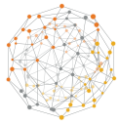
OEA Workshop
1
Create an OEA Workbench environment in your Redbox subscription

Slide 2
Prep Materials
Prerequisites:
A Redbox account: https://commercialcloud.optum.com/docs/redboxintro.html
Access to GitHub Enterprise (https://github.optum.com)
A Secondary ENTID Account (user@entid.optumhub.net)
Important Links:
Commercial Cloud Portal: https://commercialcloud.optum.com
Azure Portal: https://portal.azure.com
GitHub Redbox: https://github.optum.com/CommercialCloud-Redbox-Azure
Jenkins Redbox: https://jenkins.optum.com/redbox/

Slide 3
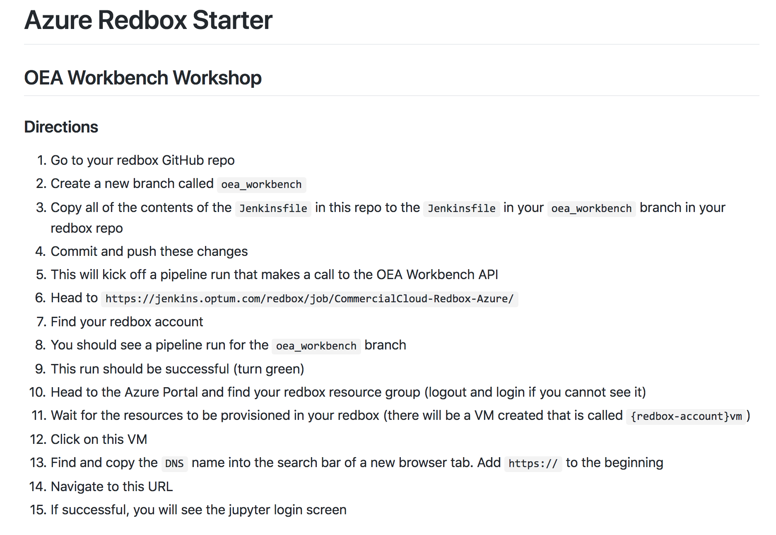
Prep Materials
Here are the instructions if you want to work ahead…
https://github.optum.com/CommercialCloud-Redbox-Azure/azure_starter/tree/oea_workbench

Slide 4
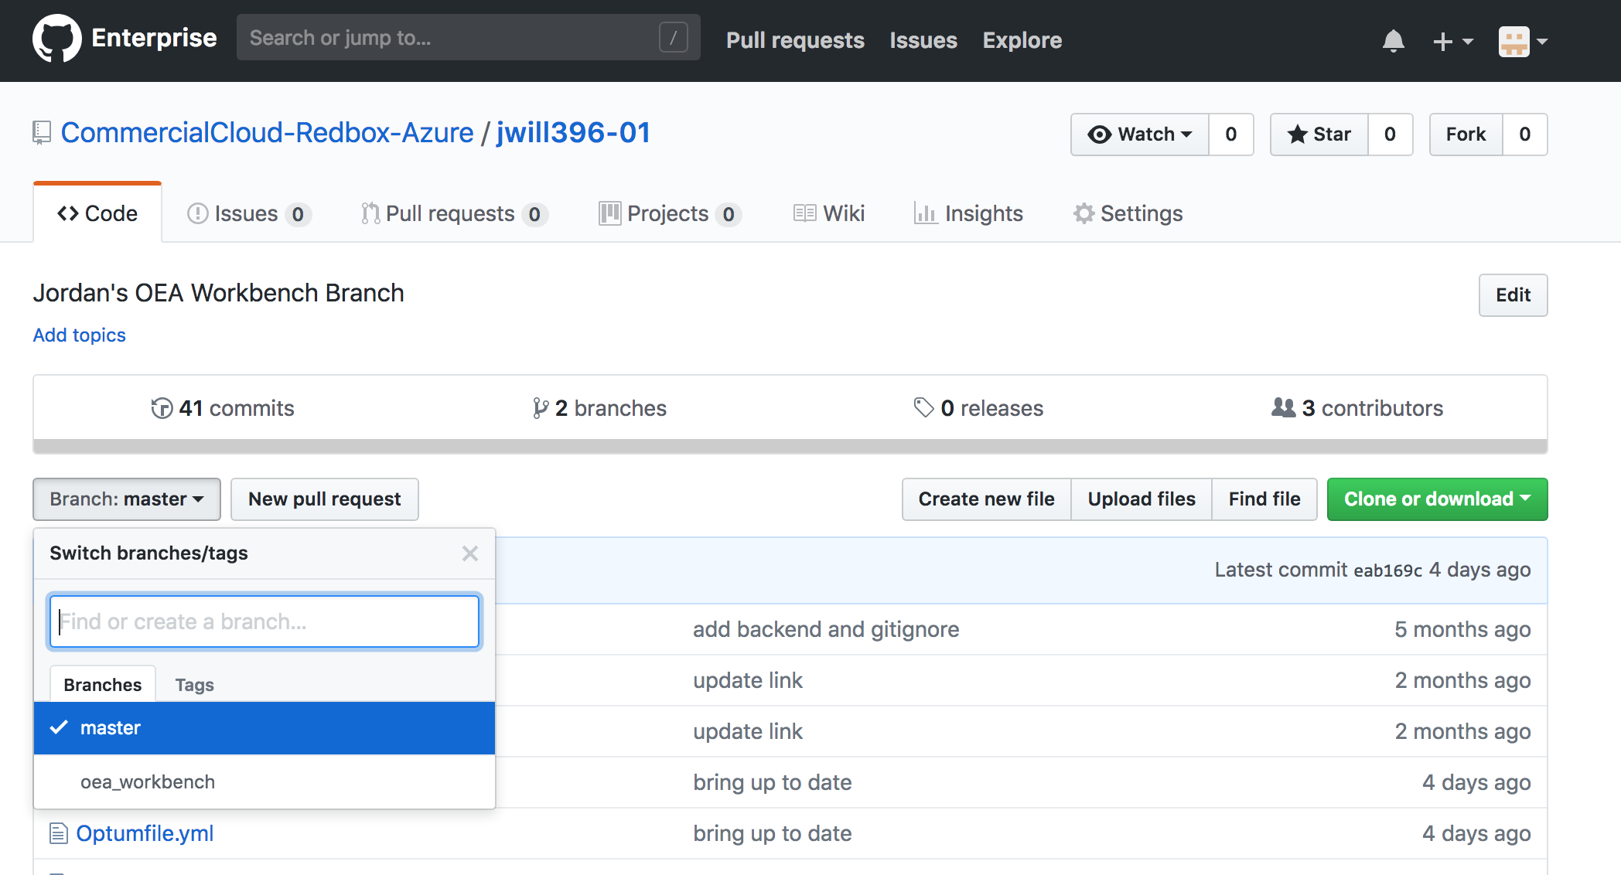
OEA Workshop
Login to GitHub: https://github.optum.com
Download Example Files: https://github.optum.com/jwil278/redbox-examples
Save to your desktop
Navigate to your Redbox Repo: https://github.optum.com/CommercialCloud-Redbox-Azure
Locate your repo by ENTID
1
In your redbox repo, create new branch and name it “oea_workbench”

Slide 5
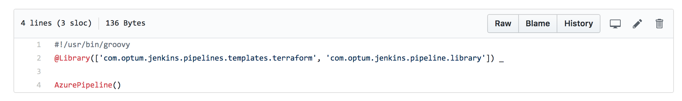
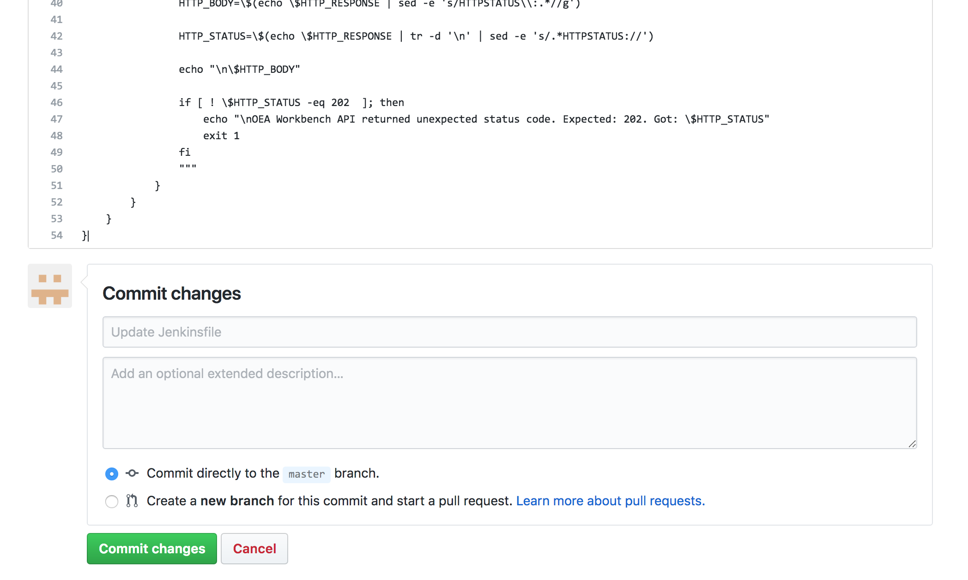
OEA Workshop
Copy all of the contents of the Jenkinsfile in the "Azure Starter" repo to the Jenkinsfile in your oea_workbench branch in your redbox repo
Commit and push these changes. Upon commit the build will automatically start. (this will take ~8 minutes)
2
3

Slide 6
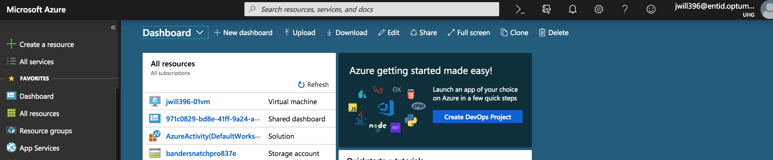
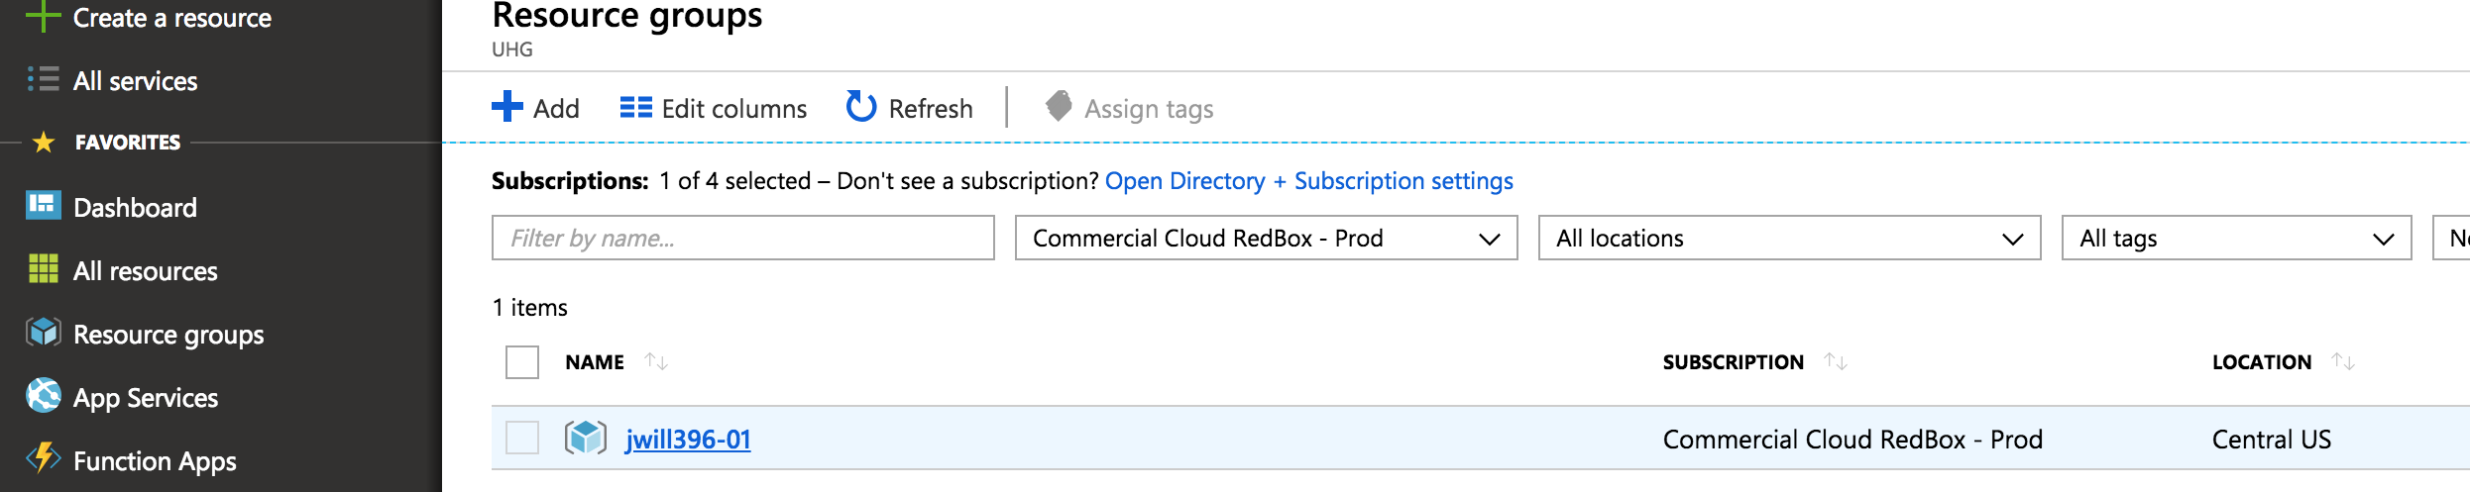
OEA Workshop
Login to the Azure Admin Portal using your ENTID credentials: https://portal.azure.com
Navigate to the “Resource Groups” page
4
Click on your redbox resource group
5

Slide 7
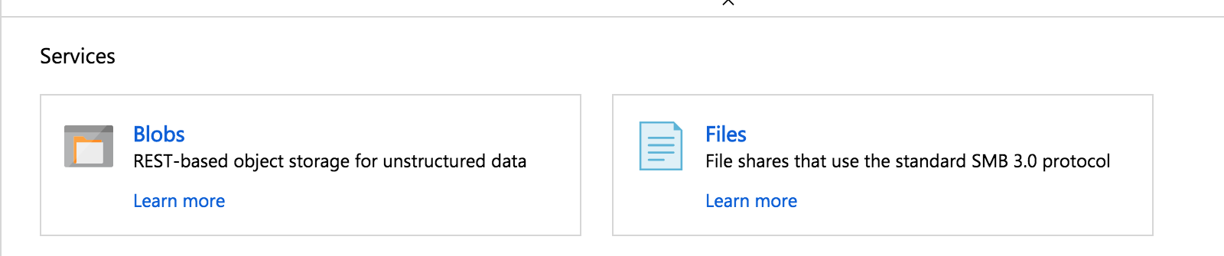
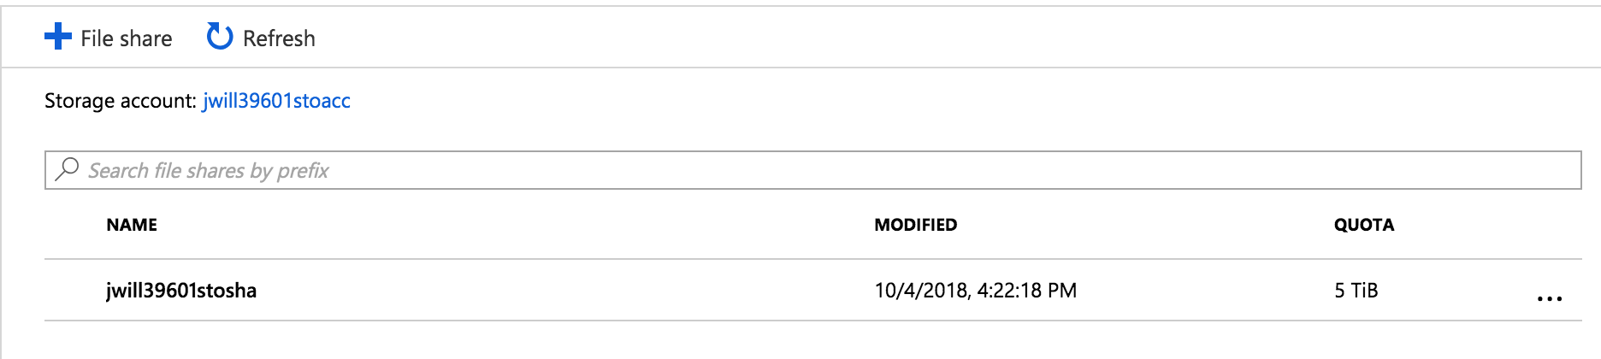
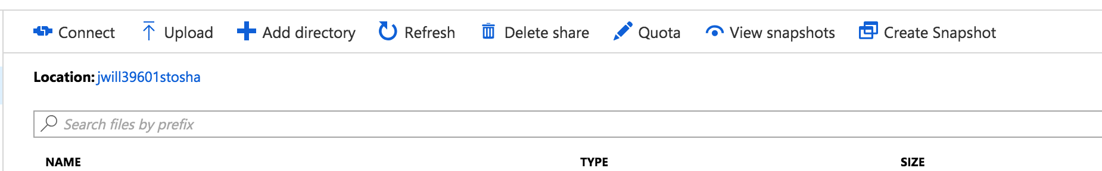
OEA Workshop
Locate your Shared Account
Upload the files from the downloaded “redbox-examples” repo to the storage account
6
6
7

Slide 8
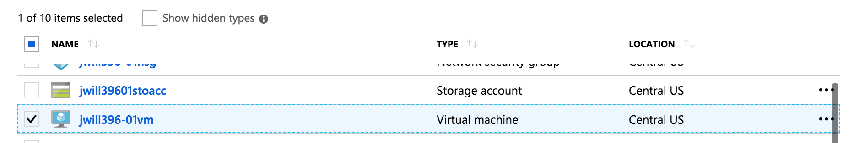
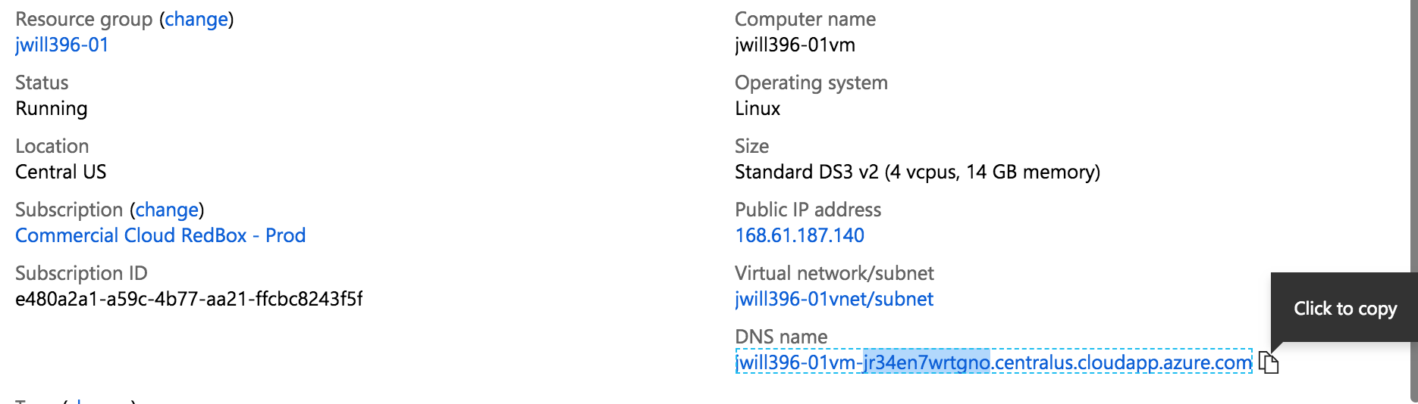
OEA Workshop
Navigate to your workbench VM details to locate and open the VM URL
Click “Resource Groups” --> Your Redbox Resource Group → Your VM
8
8

Slide 9
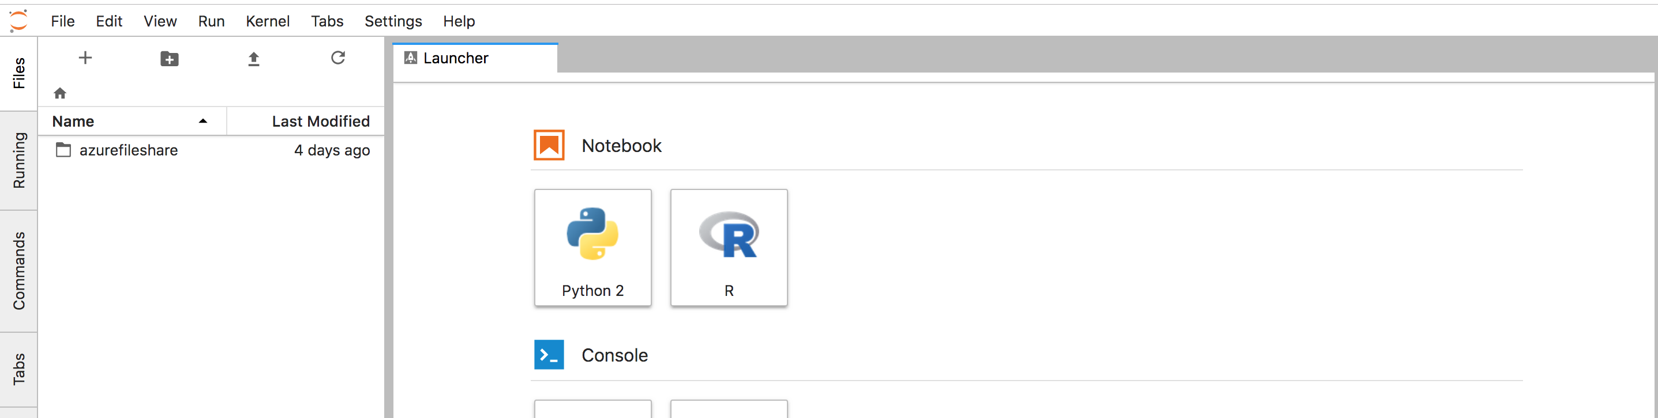
OEA Workshop
Login with credentials from Jenkins
Password for the demo is: Aeef93#peE)E7gH
Drill into azurefileshare and open the Jupyter Notebook files to walk through the sample problems
10

